Slide 1
Foreign English Test Capital
Powered by Gina Abroad Pvt. Ltd.

Slide 2





We're excited to collaborate with R.H. Patel Institute of Technology to expand opportunities for your students and enhance faculty development. Our comprehensive approach combines international university partnerships, career counseling excellence, and certified training programs.
This partnership opens doors to global education while supporting your institution's growth and your student's success
.
.

Slide 3

About Us
At FETC, We offer excellence in English language training and are dedicated to helping students and professionals achieve their dreams of studying, working, or settling abroad.
We connect you with a world of opportunities through top-notch English language support, making your application process for international education and careers smooth and successful.
With a proven track record of accommodating numerous exam stations, FETC excels in providing high-quality assessments for students, and spouses aiming for opportunities in the UK.

Slide 4






Our Services
Study Abroad
Career Counselling
Language Training
Visa Consultation
Fully Funded Education
Visa Dates & Preparation

Slide 5





Prime Study Destinations
UK
USA
Australia
Europe
Ireland

Slide 6
Agenda of Our Partnership
Professional Training: Certified TOEFL and SELT training programs for faculty members, enhancing teaching capabilities and career advancement opportunities.
Career Counselling: Expert guidance helping students navigate career paths, university selections, and global opportunities with confidence.
University Visits: Direct campus visits from international university representatives, providing students with firsthand information about study abroad options.
City College Birmingham (2+1): Explore your path to Accredited qualifications. Complete your first two years in India, pathway to aboard.

Slide 7


Benefits for Your Faculty Members
Certified Training Programs: Official TOEFL and SELT certification training that enhances your teaching credentials and opens new career opportunities.
Professional Development: Stay current with international education standards and improve your ability to guide students toward global opportunities.
Referral Incentives: Earn referral incentives when your students enroll through our partnerships, creating additional income streams for dedicated faculty.

Slide 8
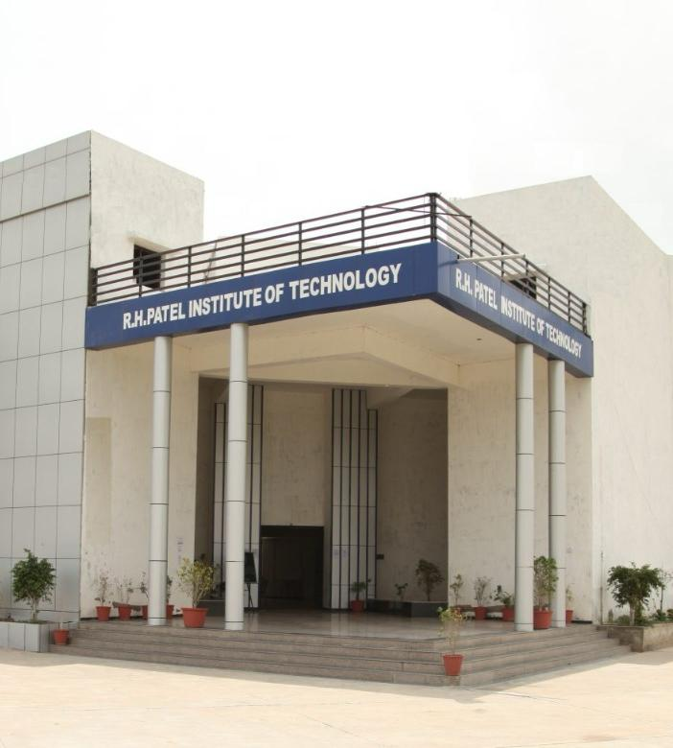
Campus Visit’s
First Visit: Bill Boozing – 3rd April2026 Curry College representative will visit your campus, sharing opportunities for American education.
Follow-Up Visits: UK University Representatives will visit, showcasing British higher education options and pathways.
Ongoing Access: Continued university partnerships expanding your students' global education choices.
.

Slide 9

Top-Notch Global Programs
IT |Computing |Digital Technology
Career Pathway
Software Developer/ Web Developer
IT Support Specialist
Network Engineer/ Cybersecurity Analyst
Data Scientist/ Business Intelligence Analyst
E-Commerce Manager
Tech Project Manager
.

Slide 10

Authorized Test Centre
FETC is proud to be the only Authorized ETS TOEFL Exam Centre in Gujarat, offering a dedicated location for essential language proficiency testing.
Our centre is equipped with the latest technology and resources to provide a seamless and efficient testing experience.
We maintain the highest standards of exam integrity and security, ensuring a professional environment for every candidate.

Slide 11

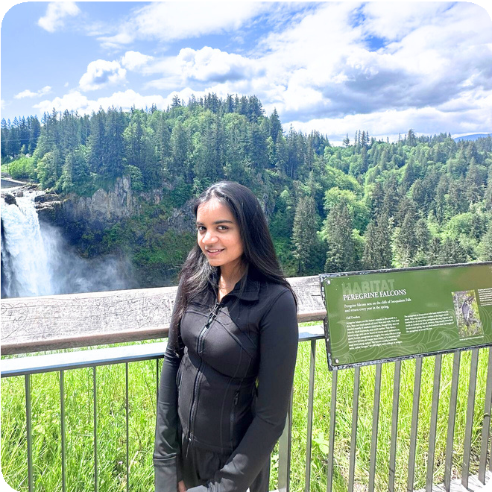
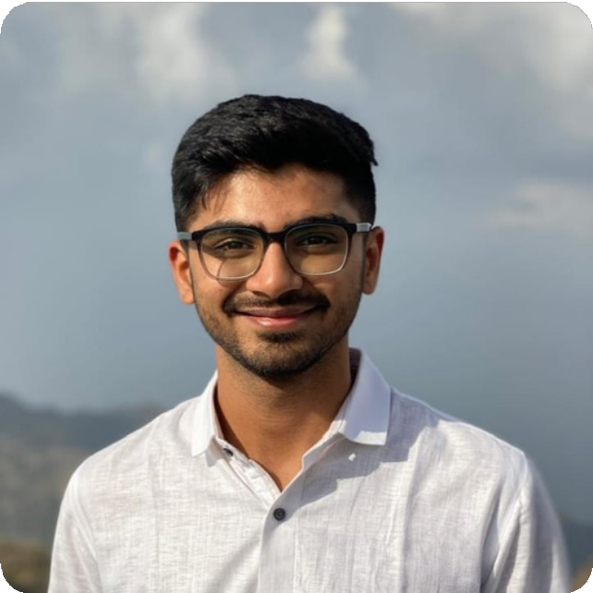
Happy Clients
Prajal Sonariya
USA F1 Visa
Mansi Savani
USA F1 Visa
Naitik Patel
Ireland Student Visa

Slide 12
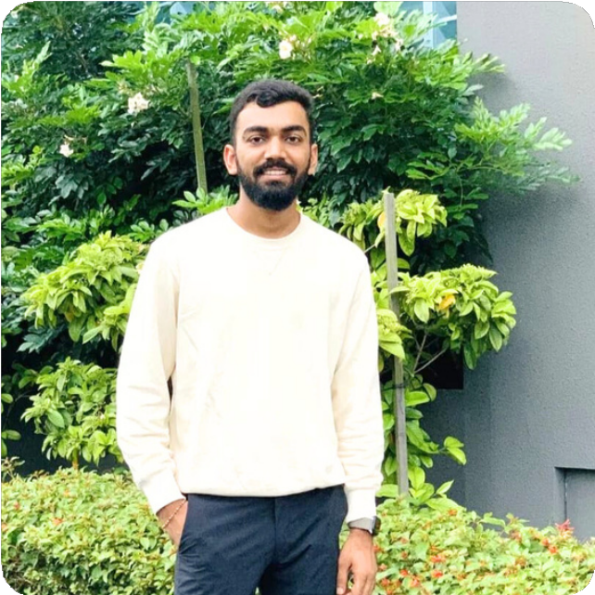

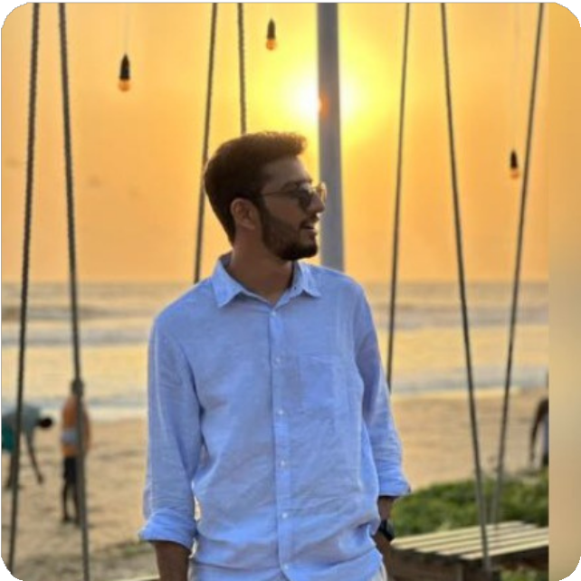
Happy Clients
Rutvik Tejani
USA F1 Visa
Prathana Dankhara
USA F1 Visa
Samarth Pachchigar
Spain Student Visa

Slide 13
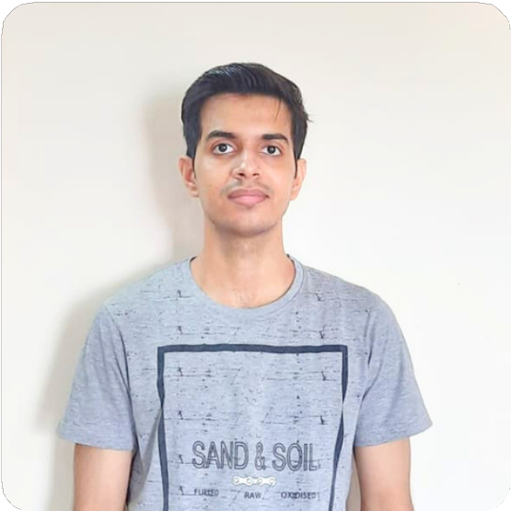

Happy Clients
With dreams of advancing his education, Udit Gangnani entrusted us with his journey. Through our dedicated support, he secured a Fully funded scholarship to study Data Science at the University of Pisa.

Slide 14
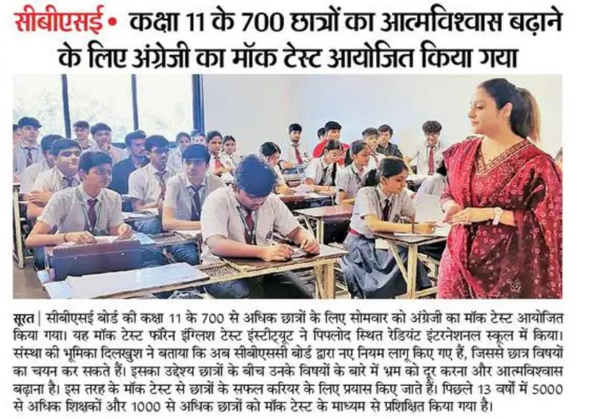
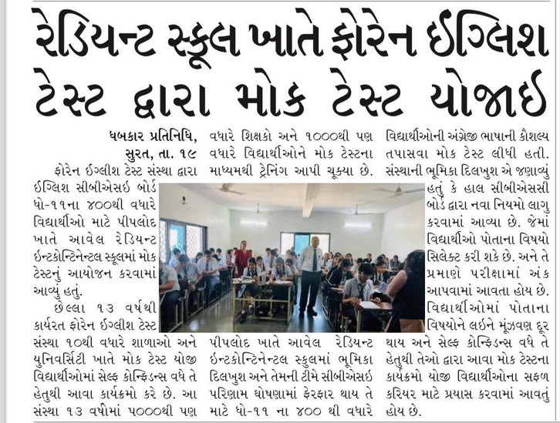
Breaking the record of 3000+ students

Slide 15
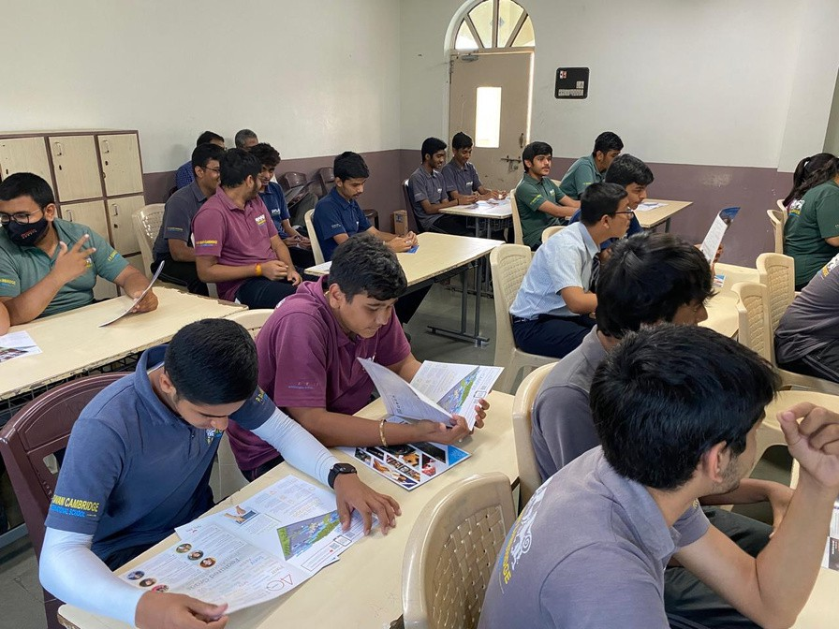
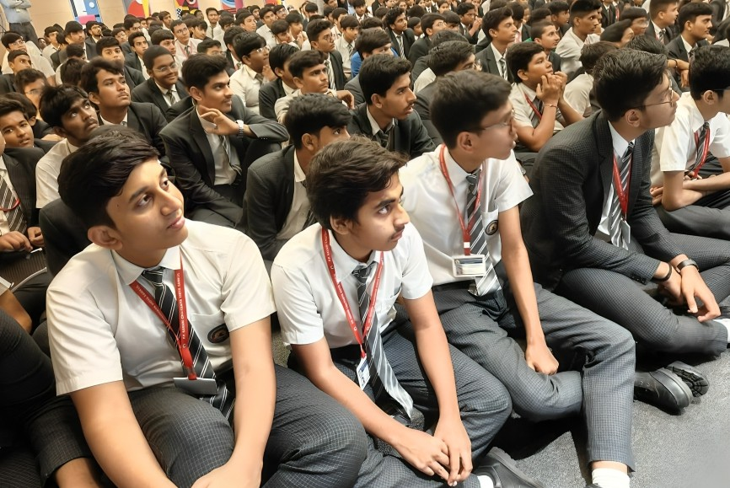
Free Seminars

Slide 16
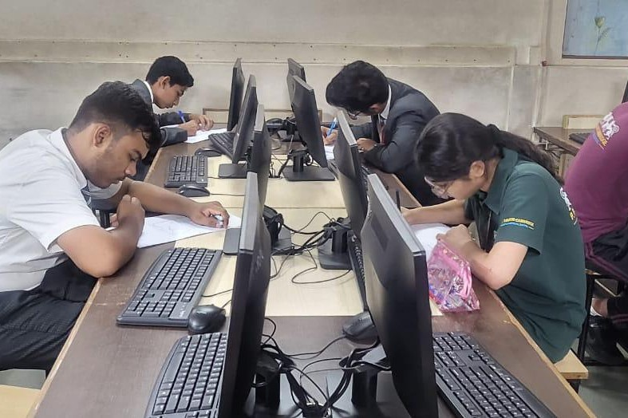
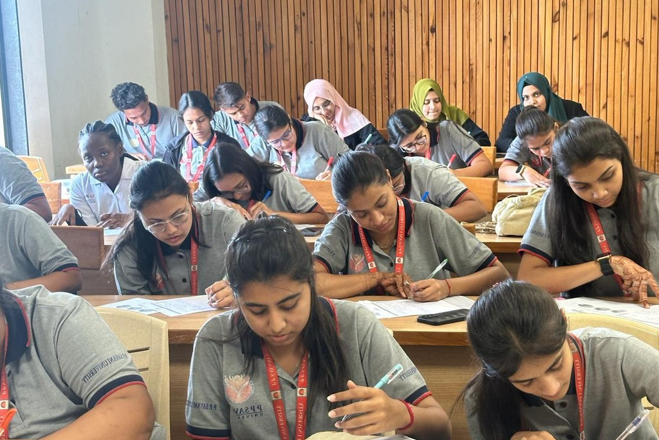
Mock Tests

Slide 17
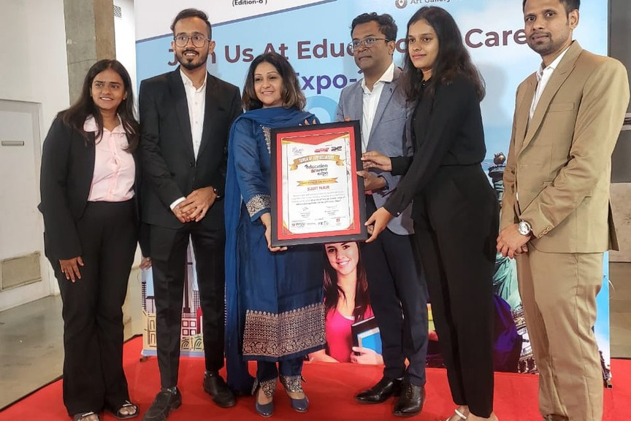
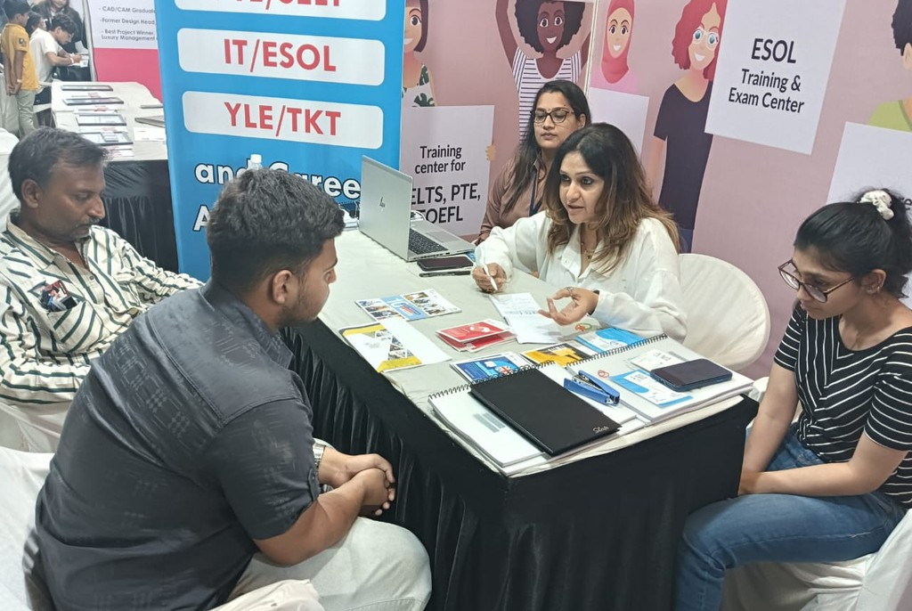
Education Expo with Campus France Director

Slide 18
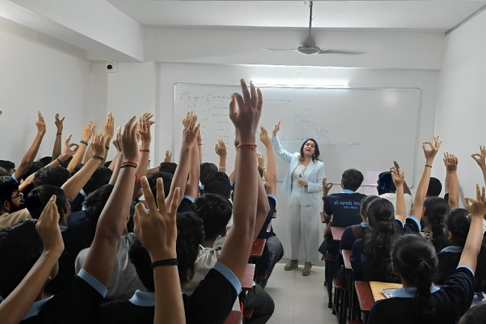
Young Mind Career

Slide 19
Thank You

